Slide 1
User Authentication
Using Double Hashing

Slide 2
Team b-17
Parthvi Manoj | CB.EN.U4AIE21143
Sakthi Swaroopan S | CB.EN.U4AIE21159
Sanjay Chidambaram | CB.EN.U4AIE21160
Tarunesharan | CB.EN.U4AIE21170

Slide 3
The 4 Principles of Cryptography
Confidentiality
OpenSSL, AES, SHA256, KDF
Data Integrity
SQL Alchemy
Authenticity
User Authentication by matching Hashes
Non-repudiation
OpenSSL, CSRF Protection, Flask

Slide 4

What we will be implementing
We will be implementing the concept of double hashing along with all the layers of protection against various attacks, into a Python Flask Webserver.
This way we will be taking the Server-Client Model and interaction protection into consideration.

Slide 5
Core Cryptography logic | Server Side

Slide 6
Key Derivation Functions that are used to convert low-entropy passwords to high-entropy complicated password for further processing
Key Derivation Function
Salts are random values generated and added to the password before hashing. They are unique for each user, even if they use the same password. They are stored along with the hash.
HASH SALTING
Pepper is also like Salts but it’s a singular value stored separately outside the main database. The pepper value is the same for every user.
[REMOVED]
Due to Inefficiency
Hash peppering
Double Hashing
Hashing the password twice using the same or different hashing algorithm for added computational complexity.
[Replacement] for Pepper
Advanced Encryption Standard(aes)
Encrypting the hash value before storing it into the Database, to ensure that the password cant by brute forced directly if there is a database leak

Slide 7
Flow of the overall hashing operation
Plaintext password input
Key Derivation Function (KDF)
Salting
Double Hashing
Storage
AES Encryption

Slide 8
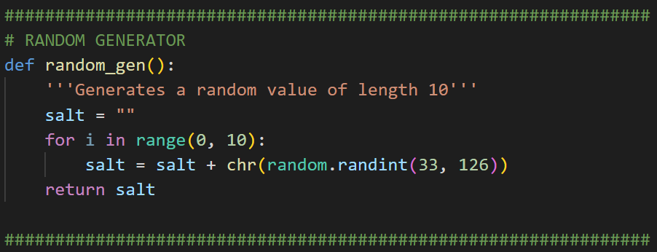
Random generation function
Generating a string of random characters based on the ASCII Value generated in the random function
We will be using this function to generate random Seeds, First time Peppers and CSRF tokens.

Slide 9
Key Derivation Function (PBKDF2 – Password based key derivation function)
Generating Key Derivation Function Salt
Generate a different salt from the Salt we use outside KDF and concatenate it with given password. (P)
Key Derivation
Apply the HMAC function on the password(P) repeatedly based on the number of iterations(c) specified
Iterations
Every Subsequent Iteration in the Key Derivation part uses the result of the previous iteration(U_{i}) to apply HMAC on to get its current result(U_{i+1})
Finishing up
The final value(U) from the last iteration is used as the derived key. The Salt value is also stored.

Slide 10
KEY DERIVATION FUNCTION
Salt Generator
Main Input Pt - plaintext
Pseudo Random Function c = c – 1
is c<=0 ?
Concatenate
(Looping the (c) times )
Coded Parameters c - iterations L - length
Cut Key based on length required (L)
KDF Key KDF Salt

Slide 11
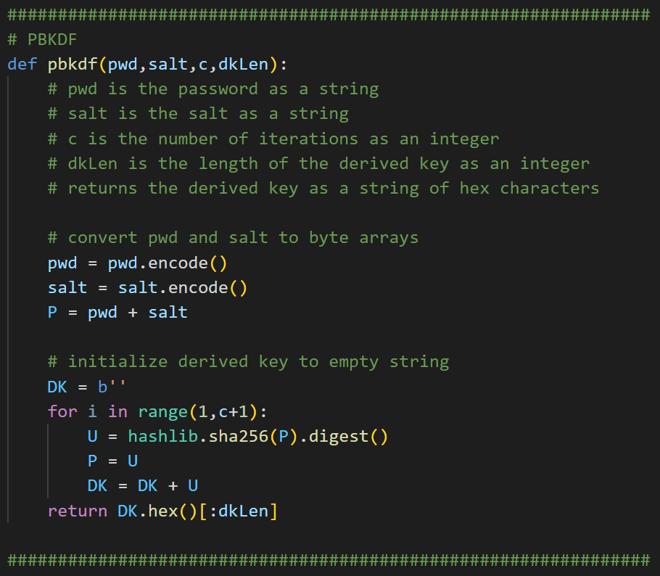
KEY DERIVATION FUNCTION

Slide 12
Hash salting (custom made random function)
Generating a Random Salt
Random Salt Value will be generated based on any existing Random functions (maybe something to do with system time)
Concatenating
Concatenating Salt with the Password to send it off for the next step in the process
Storing the Salt Value
The Salt value that was generated is stored together with the final hash value in the main database entry
Unique Salts
Even if multiple users have the same passwords the Salt Value ensures that the hash is different. It also introduces extra complexity that makes it hard to reverse compute the original password

Slide 13
Salting
Concatenate
Salted Key
Peppered Key
KDF Key
KDF Salt
Salt Generator
Storing
Main Salt
Same Random function but different Salt
Generating a Salt value and concatenating to Key

Slide 14
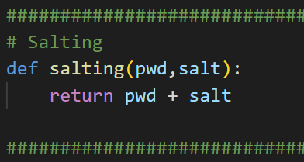
sALTING

Slide 15
Hash peppering (Stored separately from the main database)
[REMOVED]
Due to Inefficiency
Creating a Pepper Value
The Pepper value is defined once and never changed again. Could be randomly generated for the first time and stored separately
Concatenating
Concatenating Pepper with the Password to send it off for the next step in the process
Storing the Pepper Value
The Pepper value is stored separately from the main database, as this adds another layer of protection against attacks.
Single point of Failure?
The use of pepper in isolation could be a single point of failure, but in combination with other security measures, such as salting and key derivation, the system remains robust, and the compromise of the pepper alone doesn't jeopardize its security.

Slide 16
Peppering
[REMOVED]
Due to Inefficiency
Generate Pepper
Storing
Store Pepper
pepper exists?
High Entropy Key
Peppered Key
Concatenate
Retrieve Pepper
Generate Key if it doesn’t exist and concatenate it with salted key

Slide 17
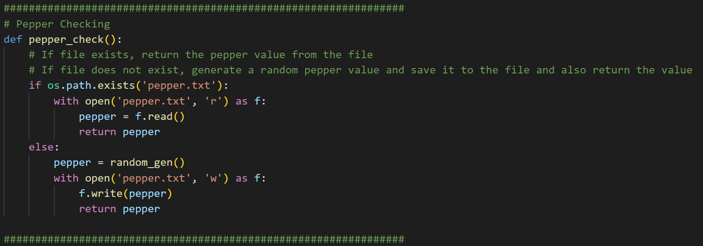
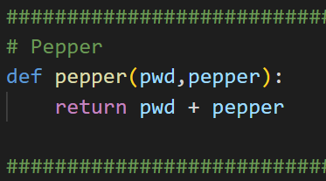
PEPPERING
[REMOVED]
Due to Inefficiency
We left this logic in the code as comments for any future reference

Slide 18
Double Hashing and storage (SHA-256 and sha-512)
Final Step
After all the preprocessing we get the password and hash it using the 2 existing hash functions , SHA-256 and SHA-512
Hashing Twice
We simply put the password through the first hash function and put the result of that through the second hash function to get our final hash
Storing the Hash
The final hash is stored along with the Salt value and the KDF Salt value we used previously. The Data will be stored in a JSON for this project

Slide 19
Peppering
Salt and Peppered Key
SHA256
SHA256
Final Hash
Storing
Performing Hashing Twice

Slide 20
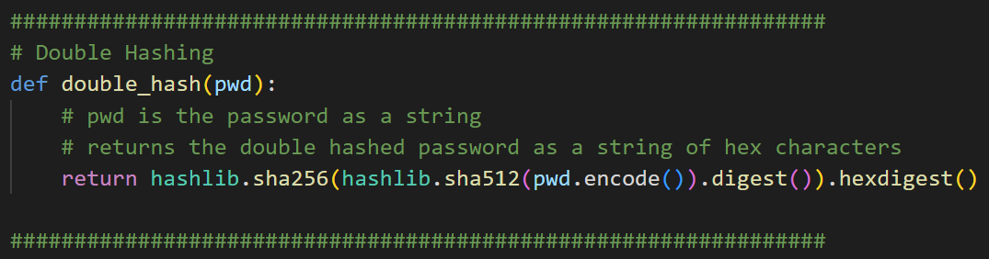
Double hashing

Slide 21
AES Encryption (aes – Advanced Encryption standard)
[Replacement] for Pepper
Defining the Key for encryption
We define a key value that is being used for encryption. Conventionally we would be implementing a Rotating Key System.
Encrypt Function
We will be using a Stream cipher model, having a pseudo-randomly generated initialization vector. The Initialization vector is concatenated with the cipher text and returned.
Decrypt Function
Retrieves the Initialization vector from the first 16 bytes of the ciphertext and decrypts using previously mentioned key
Opens up the Possibility for Rotating Keys
Since the Key is a encryption key unlike the pepper, this allows us to implement a rotating key system where the key could be changed at automated intervals as pear our preference. This is not implemented.

Slide 22
AES Encryption during hashing
[Replacement] for Pepper
Input
Double Hashed Value
Advanced Encryption Standard (AES)
Encrypt
Encrypted Hash
Storing
Coded Parameters key - ”Batch B Group 17”*2

Slide 23
AES Decryption during verification
[Replacement] for Pepper
Input
Encrypted Hash Value
Advanced Encryption Standard (AES)
Decrypt
Decrypted Double Hash
Checking for Match
Coded Parameters key - ”Batch B Group 17”*2

Slide 24
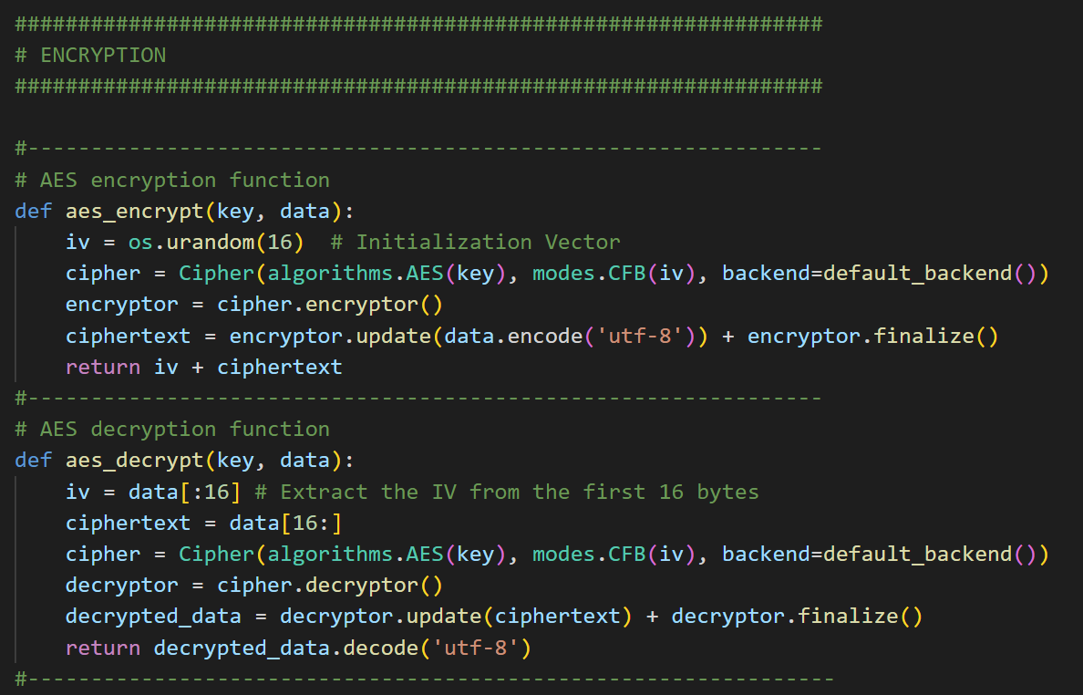
AES Encryption Function
[Replacement] for Pepper

Slide 25

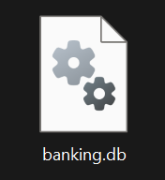
Original Idea
pepper.txt
Pepper
Salt Value
Key Derivation Function
(KDF)
Double Hash Function
Password Plaintext
Hash Value
Concatenate
Concatenate
Username
User | KDF Salt | Main Salt | Password Hash | Credit Value
Sakthi | M+z"#0b>f] | zE6tOSiMr< | f58d596063… | 10000.0
… | … | … | … | …
Final Flowchart

Slide 26
Improved Theoretical Idea
Hardware Security Module (HSM)
or Key Manager
Salt Value
Key Value
Key Derivation Function
(KDF)
Double Hash Function
Advanced Encryption Standard (AES)
Encrypt
Encrypted Hash Value
Password Plaintext
KDF key
Concatenate
Username
KDF Salt
User | KDF Salt | Main Salt | Encrypted Hash | Credit Value
Sakthi | M+z"#0b>f] | zE6tOSiMr< | f58d596063… | 10000.0
… | … | … | … | …

Slide 27
Implemented Idea
Salt Value
Coded Key Value
Key Derivation Function
(KDF)
Double Hash Function
Advanced Encryption Standard (AES) Encrypt
Encrypted Hash Value
Password Plaintext
Concatenate
Username
User | KDF Salt | Main Salt | Encrypted Hash | Credit Value
Sakthi | M+z"#0b>f] | zE6tOSiMr< | f58d596063… | 10000.0
… | … | … | … | …
Final Flowchart

Slide 28
Verification process
Key Derivation Function
(KDF)
Double Hash Function
Give Password
Concatenate
Double Hash of Given Password
Match?
Advanced Encryption Standard (AES) Decrypt
Given Username
Encrypted Hash from database record
User | KDF Salt | Main Salt | Encrypted Hash | Credit Value
Sakthi | M+z"#0b>f] | zE6tOSiMr< | f58d596063… | 10000.0
Coded Key Value
Retrieved record based on Username

Slide 29
Admin POV
Has Access to the following:
C – Iterations of KDF
Key – Key for AES

Slide 30
User POV
Has Access to the following:
Username
Password

Slide 31
Database POV
Has Access to the following:
Username
KDF salt
Main salt
Encrypted hash
Credit value

Slide 32
CODE/Progammer POV
Has Access to the following:
L – Length of Hash Algorithm to be given for KDF

Slide 33
How the storage is being handled in the project
User
banking.db
KDF Salt
Record for 1 user
Main Salt
Hash Value
Credit Value

Slide 34
Flask integration | Server Side

Slide 35


FLASK Implementation Details
We will be creating a Flask Web Server with SSL Certificate system for Securing the connection between the Client and the Web Server.
Since this is a local implementation we have a self-signed SSL Certificate made using OpenSSL for this Implementation
This might show a “Invalid Certificate” in most modern browsers due the fact that there is no proper Certification Authority recognizing our local ip web page, but this is not the case in proper production level implementations
In Production level, a reverse proxy server will be used, example: nginx

Slide 36
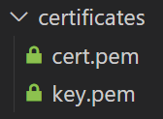
Why Self Signed Certificates?
Since we opted for a Self Signed Certificate for securing the connection for this simple project level implementation, we don’t have a Certification Authority authorizing our domain and site.
Though an ad hoc option is available in flask which uses dummy SSL certificates, we still opted for a manual implementation with generated certificates.
This Certificates works just as well as the CA-authorized certificates.

Slide 37
Why Self Signed Certificates?
Here are the commands used for generating these certificates using OpenSSL
openssl req -x509 -newkey rsa:4096 -nodes -out cert.pem -keyout key.pem -days 3650
This command generates a 2 certificate files of X.509 format, where cert.pem is the public key and the key.pem is the unencrypted private key.
Both these certificates are set to be valid for 3650 days (10 years)
Usually the private is key is encrypted separately to be stored in the app server, for protection.

Slide 38
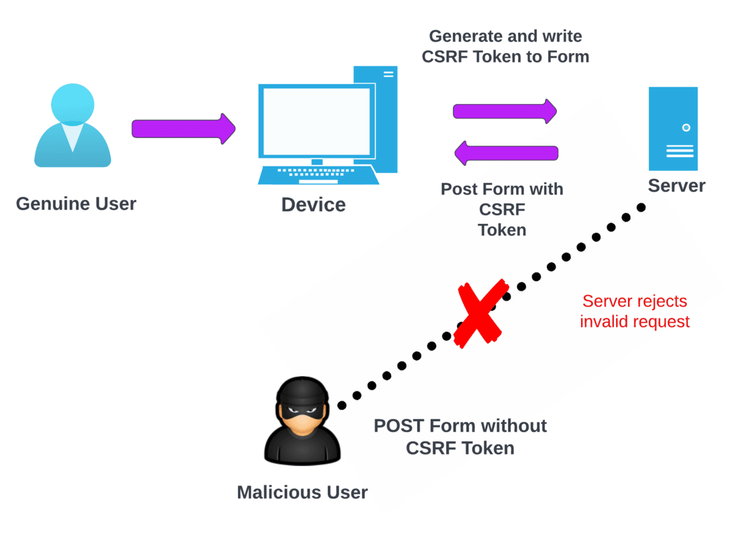
Cross Site REQUEST FORGERY (csrf)
Cross Site Request Forgery is when a Cross-Site Request Forgery (CSRF) is a type of web attack where a malicious website tricks a user's browser into making an unintended and unauthorized request to another site where the user is authenticated.
This attack takes advantage of the fact that browsers automatically include any relevant cookies, including session cookies, with requests made to a particular domain.
In our implementation we dont have any cookies, rather we need to protect the various html forms we have on the webpage.

Slide 39
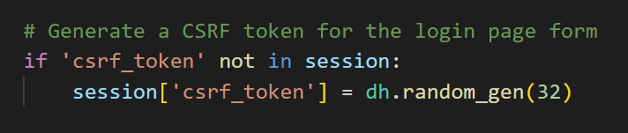
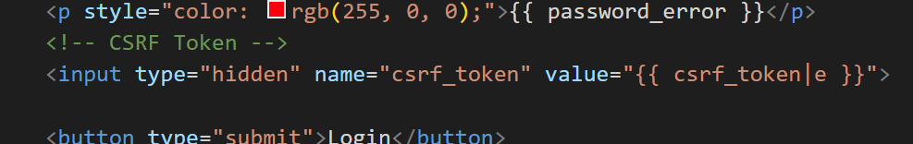
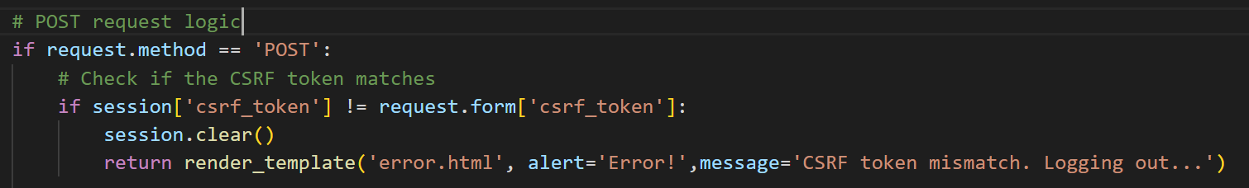
Cross Site REQUEST FORGERY (csrf)
For every form that is being sent to the client, at that moment a csrf-token is randomly generated
This csrf token is sent through a hidden element in the html form when the client does a GET request.
When the client submits the form, the csrf-token is verified and the session is validated

Slide 40
Other Important Details
Other than CSRF Protection we also have the following
A simple timeout for the banking page
Limited attempts at Sign-Up and Sign-In pages
Any error that occurs in the banking page that could have been caused maliciously, instantly logs the user out
Important Improvements to consider
Database Backup System
Rotating Encryption Key System (Wouldn’t be possible with Pepper!)
Hardware Security Module (HSM) (or) Cloud based Key Management for storing Key value for Encryption.

Slide 41
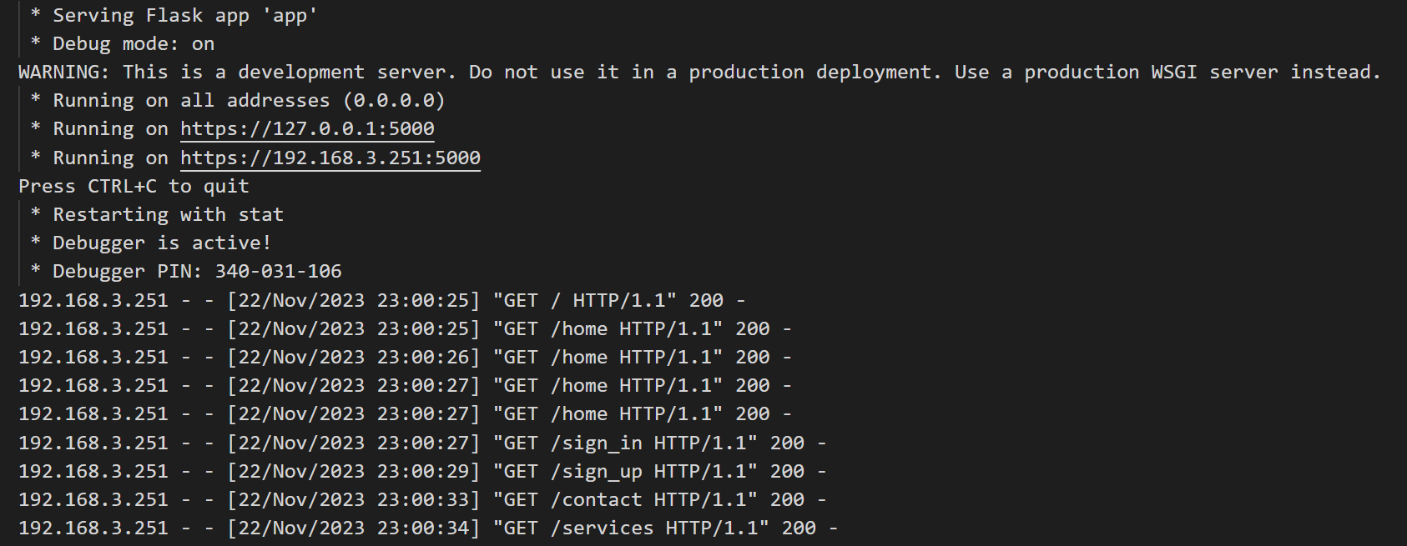
Flask WEBPAGE IMPLEMENTATION

Slide 42
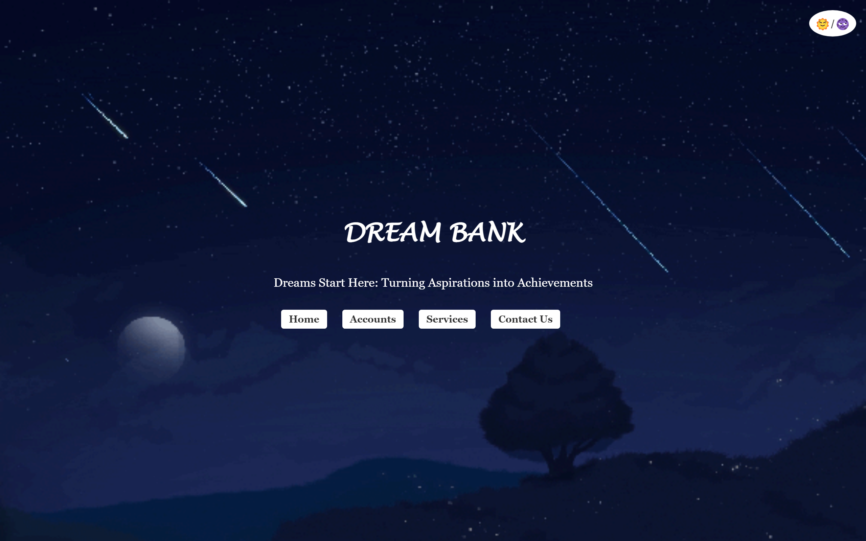
Flask WEBPAGE IMPLEMENTATION
Home page

Slide 43
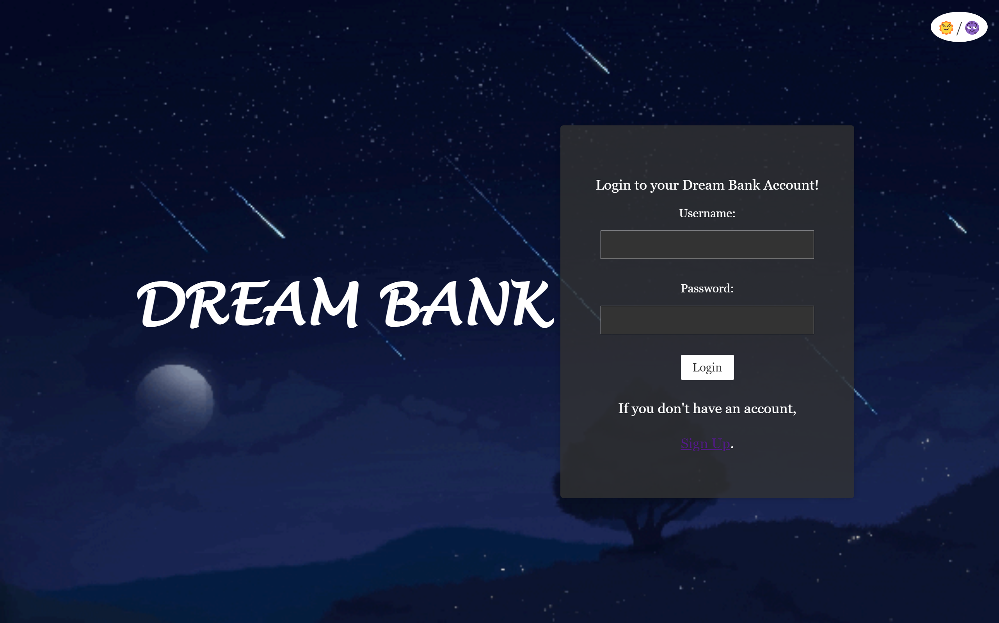
Flask WEBPAGE IMPLEMENTATION
Login Page

Slide 44
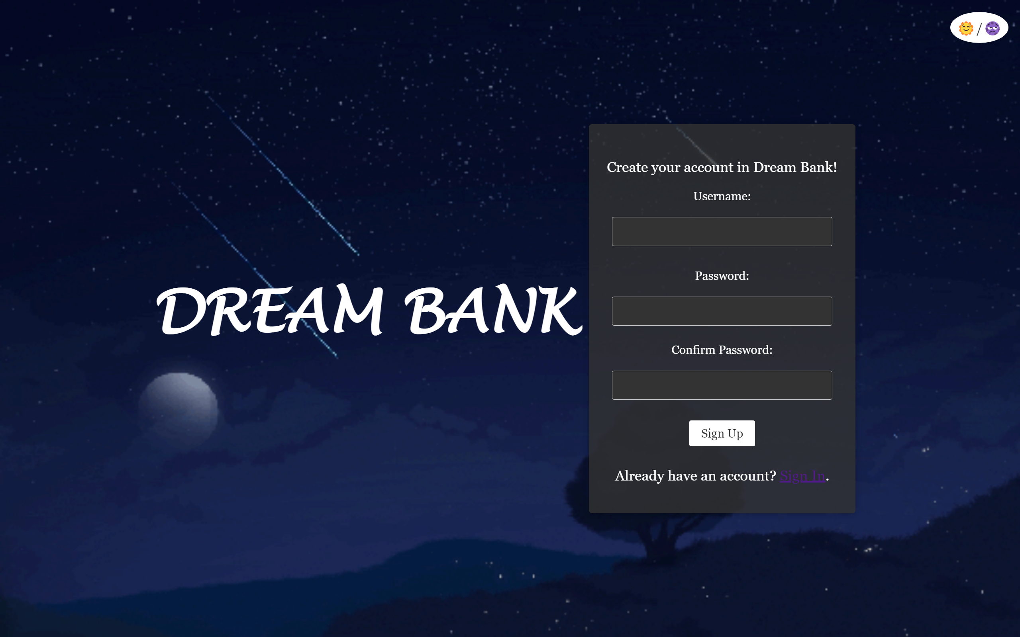
Flask WEBPAGE IMPLEMENTATION
Sign up Page

Slide 45
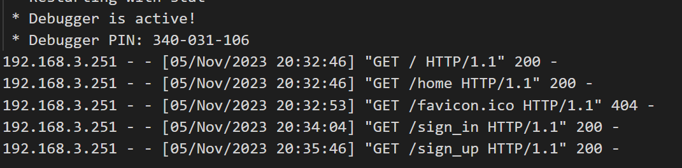
Flask WEBPAGE IMPLEMENTATION
We can see the HTTPS requests the webserver is getting

Slide 46
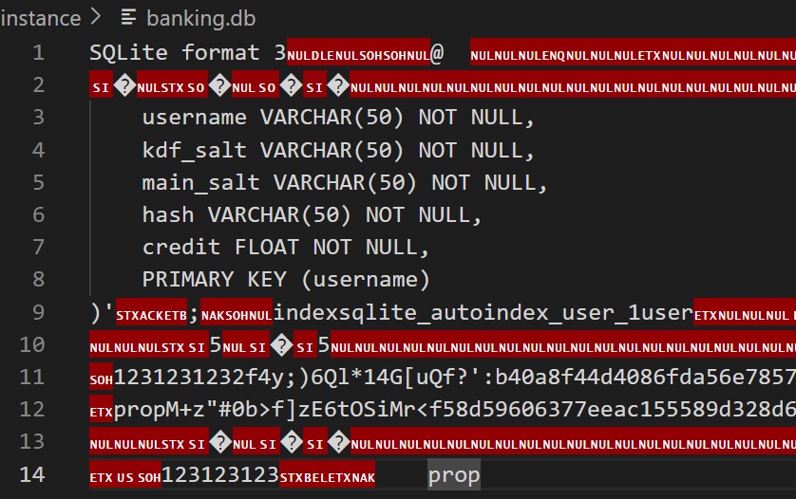
Files used for storage
SQL DATABASE FILE

Slide 47
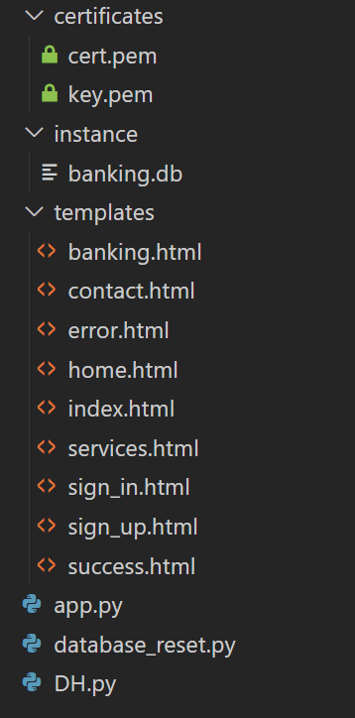
FILES REQUIED FOR THE WEB’S FUNCTIONALITY

Slide 48

Second Language Implementation | JAVA
We have implemented the core cryptographic login in Java

Slide 49
Java – Implementation of Double Hashing
Hashing
Salting
AES
KDF

Slide 50
Code Sequence
Data Storage and Serialization
Save User Passwords to JSON
Load User Passwords from JSON
Save Transactions to JSON
Password Hashing
PBKDF2
Double Hashing
AES Encrypt Double Hashed Password
AES Decrypt Double Hashed Password
User Management
Sign Up
Main Method
Main method handling user interactions and system flow.
Sign In
Transactions
Save Log to Log.dat
Salting
Double Hashing

Slide 51
Implementation of SecureUsermanagement.java
Main Method (main):
Presents a menu for users to either sign in or sign up.
Depending on the user's choice, it either initiates the sign-in process or the sign-up process.
After successful sign-in, the user can perform credit or debit transactions, with the details recorded in the transaction history.
Sign-In (signIn):
Validates the entered username and password against the stored user credentials.
Logs successful and unsuccessful login attempts.
Sign-Up (sign_up):
Registers a new user by collecting a username, password, and initial deposit.
Performs password hashing and salt generation.
Saves the new user's details to the userPasswords map.
Save User Passwords to JSON (saveUserPasswordsToJson):
Uses Jackson library to serialize and save the userPasswords map to a JSON file.

Slide 52
Implementation of SecureUsermanagement.java
Load User Passwords from JSON (loadUserPasswordsFromJson):
Uses Jackson library to deserialize and load user passwords from a JSON file into the userPasswords map.
Get Transaction History (getTransactionHistory):
Retrieves transaction history for a specific user from the transactions list.
Add Transaction (addTransaction):
Adds a new transaction entry to the transactions list.
Logs the transaction addition.
Get Current Date (getCurrentDate):
Returns the current date in a specific format.
Save Transactions to JSON (saveTransactionsToJson):
Uses Jackson library to serialize and save the transactions list to a JSON file.
Update Credit and Save (updateCreditAndSave):
Updates the credit balance of a user based on credit or debit transactions.
Saves the changes to the userPasswords map and transactions list.

Slide 53
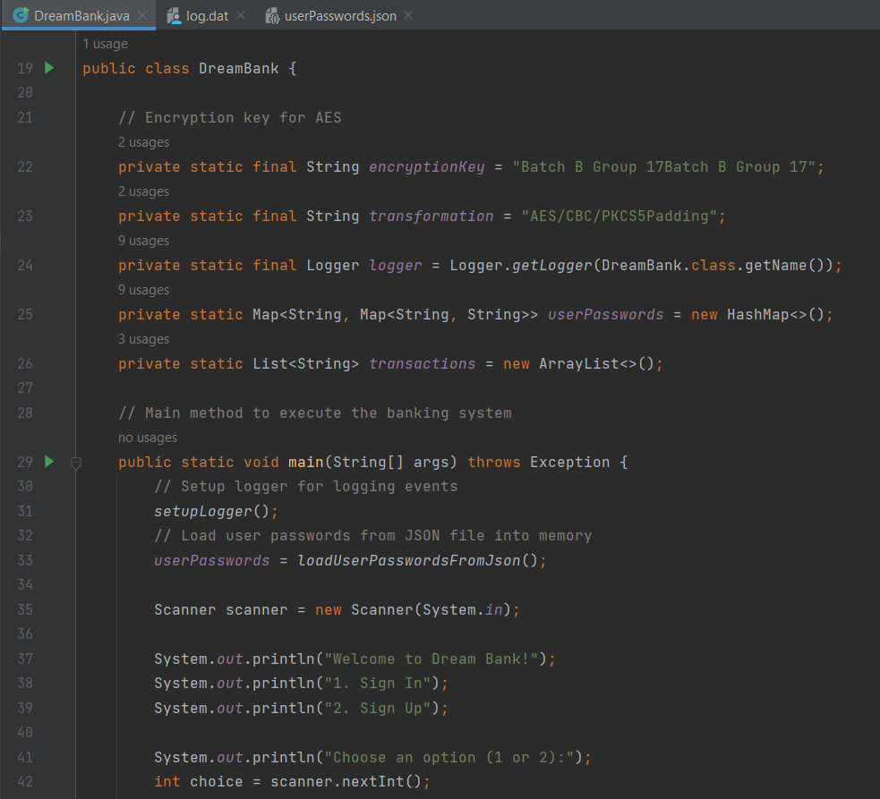
Java:
Code

Slide 54
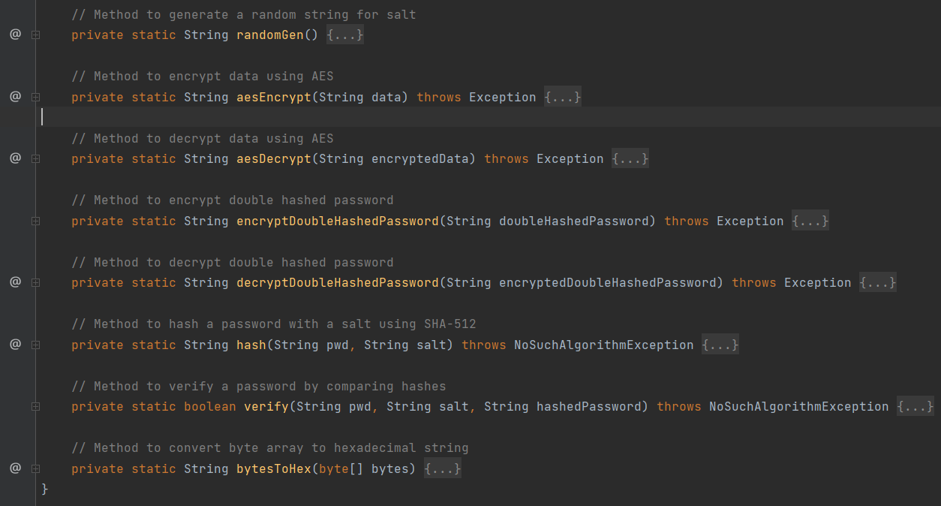
Java: Code

Slide 55
Implementation of SecureUsermanagement.java
Setup Logger (setupLogger):
Configures a logger to log events, errors, and warnings to a file.
Random String Generation (randomGen):
Generates a random string (used for salt).
AES Encryption and Decryption (aesEncrypt and aesDecrypt):
Encrypts and decrypts data using the AES algorithm.
Encrypt Double Hashed Password (encryptDoubleHashedPassword):
Encrypts a double-hashed password using AES.
Decrypt Double Hashed Password (decryptDoubleHashedPassword):
Decrypts a double-hashed password using AES.
Hash Password (hash):
Hashes a password using the SHA-512 algorithm with a provided salt.
Verify Password (verify):
Compares a hashed password with a provided input password and salt.
Bytes to Hexadecimal String Conversion (bytesToHex):
Converts a byte array to a hexadecimal string.
These functions collectively implement the core functionalities of the DreamBank system, including user authentication, transaction recording, and data persistence.

Slide 56
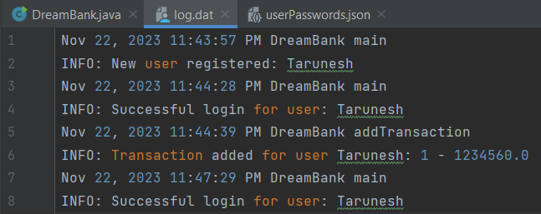
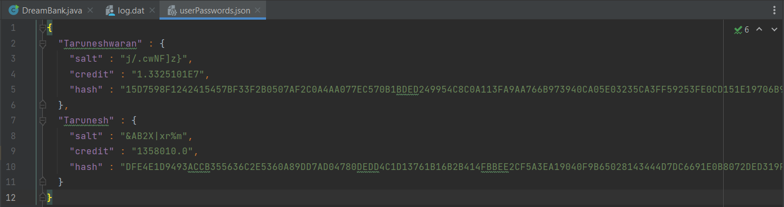
Java:
Log.dat UserPassword.json

Slide 57
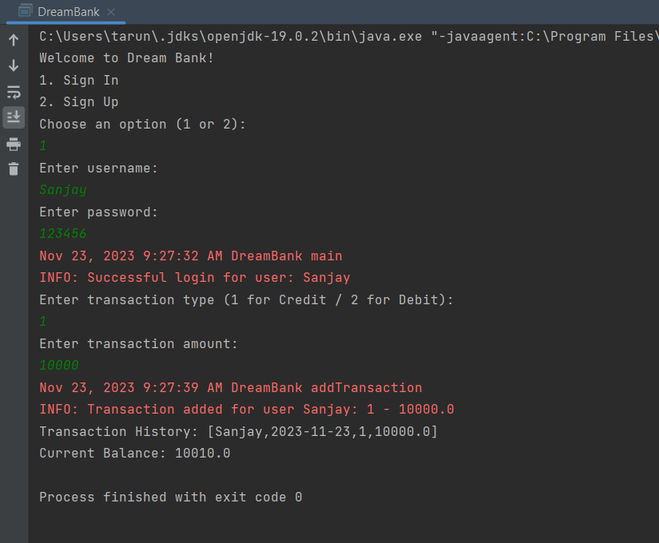
Java:
Output

Slide 58
THANK YOU
BATCH B GROUP 17

